Slide 1
Assignment 2
By William

Slide 2
Introduction
What will this presentation cover ?
Software Defined Networking and its benefits
How they’re used in the real world
How SDNs and the cloud can be used together
How UCB can begin their data migration using SDN

Slide 3
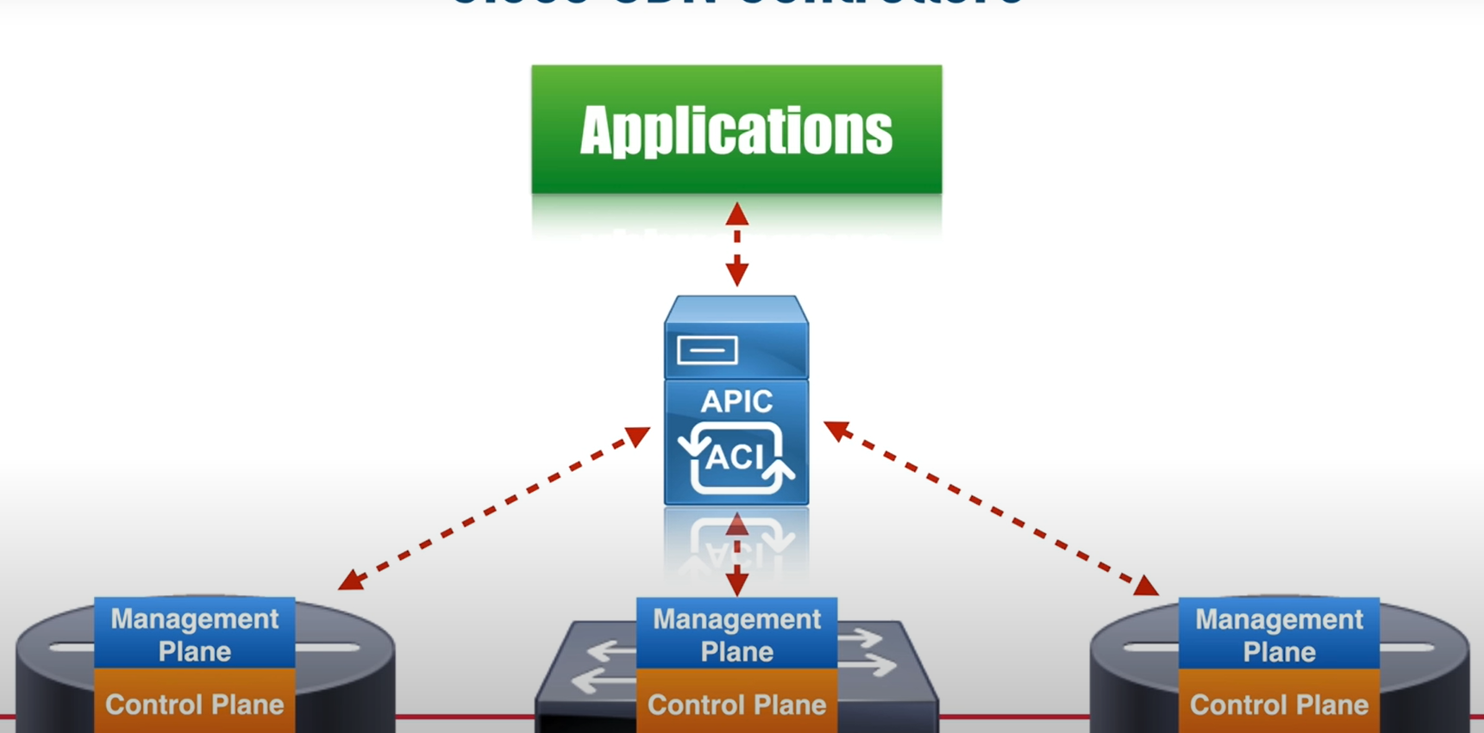
SDN Technology
What is SDN Technology?
(vmware.com, 2023), describes SDN (Software Defined Networking) as type of networking that uses “software-based controllers or application programming interfaces (APIs)”.
SDN technology can be used instead of standard components like switches, routers and cables
The software has access to the network traffic to control and direct it
(figure 1, SDN example. Youtube.com, 2018)

Slide 4
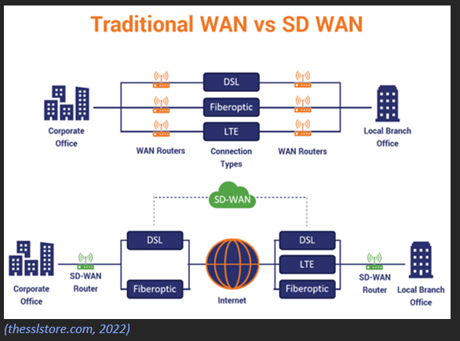
Examples of SDN
Mainly used in network virtualization, WANs and Traffic engineering (dgtlinfra.com, 2022)
Diagram above shows how SDNs in the cloud to create a WAN that bridges a connection to the DSLs in each office
UCB Can benefit from this type of connection due to amount of campuses

Slide 5
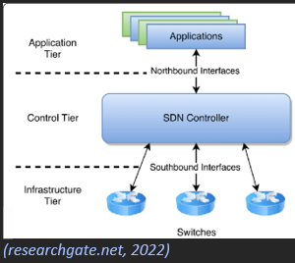
How SDNs work
How do SDNs function ?
Feature their own stack/model that has 3 layers
Application Layer – info about the entire network is communicated here. Resources are called here
Control Layer – info from the application layer is moved here and controllers determine where the packet data should go.
Device layer – Data packets from the control layer move to the device layer which then finds out where to move the data.

Slide 6
Benefits and Drawbacks of SDN Technology
What benefits will UCB receive from SDN Technology?
Automation – according to (gdit.com, 2020), businesses with “lots of uptime” will benefit greatly from having processes such as re-routing done automatically.
­Cheaper Alternative – using SDN is a lot cheaper than adding new switches and routers to a network. No need to buy new hardware
Are there any issues UCB might face?
Learning Curve - network would now have to be monitored online as well as physically. It’s possible SDN can add extra complexity for IT staff.
Incompatibility – it’s possible that using SDN in a network can cause issues when communicating information with other networks without the technology.

Slide 7
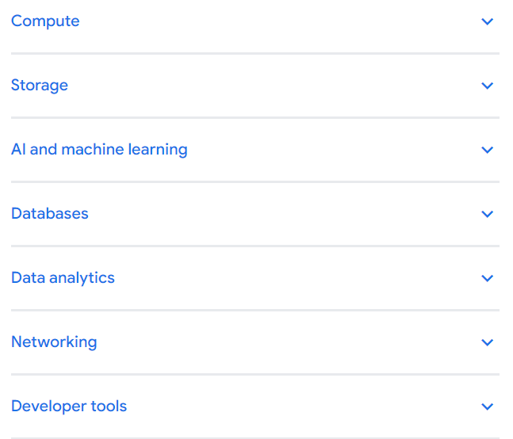
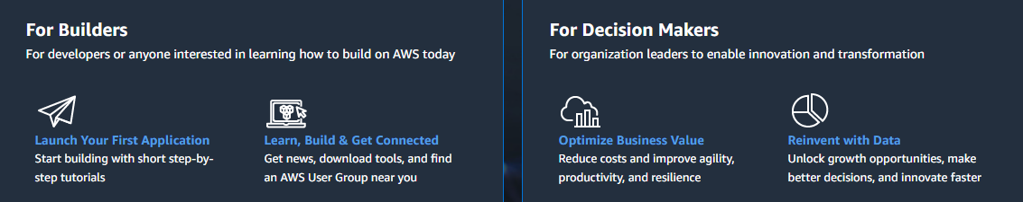
SDNs Merging with the cloud (securely)
As seen before, SDNs can be placed in the cloud to create a wireless connection between businesses.
Even though cloud computing and SDN are 2 separate technologies, they can be used together to enhance a network.
Some examples of this include:
Google Cloud – a cloud-based platform that allows users to create and visualize networks similarly to cisco packet tracer.
AWS (Amazon Web Services) – also a cloud-based platform that offers users virtual machines as well as databases and storage options.
(Figure 3, features available on google cloud. google.com, 2023)
(Figure 4, features available on amazon web services. Aws.amazon.com, 2023)

Slide 8
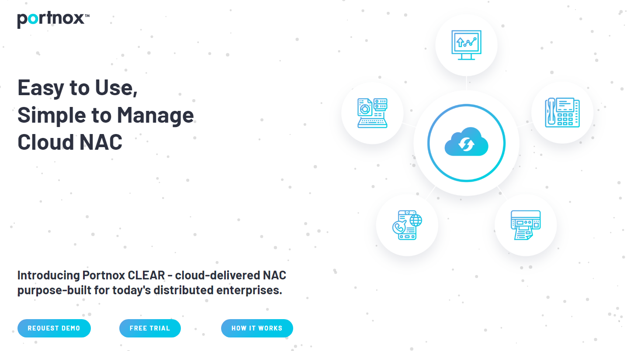
Migration Plan Readiness
(xigentsolutions.com, 2023), says one of the most important things to consider is access control. physical networks are usually limited to who can use what, a software-defined network should only be managed by the appropriate people
routine audits should also be in place. A specialist should go over UCBs current network and access its security level. Checking how safe it is and suggesting areas for improvement.
These can massively benefit the SDN since there may be more weak spots when using the cloud compared to physical networks.
I(figure 5, portnox network access control software. portnox.com, 2023)

Slide 9
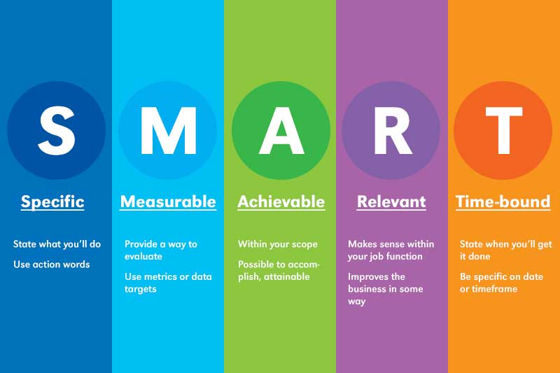
Step 1 - Agendas
What does UCB aim to achieve with the Data Migration ?
-Improved network performance
-Implementation of a newly designed system
-Data Migration Ready for the next academic year
- because of this, UCB should use “big bang or trickle migration” this is where the data is transferred in a set time frame.
(figure 6, SMART goals. Ghcc.org, 2023)

Slide 10
Step 2 - Data Analysis
The 1st thing UCB needs to do is prioritize which data is most important and needs to be transferred.
Some information they gathered from staff and students may not need to be transferred if its outdated (class ID, course start date)
Next they need to asses the file size, understanding how much data there is can be useful for setting a realistic time frame. The more information that needs to be transferred, the longer the migration will take

Slide 11
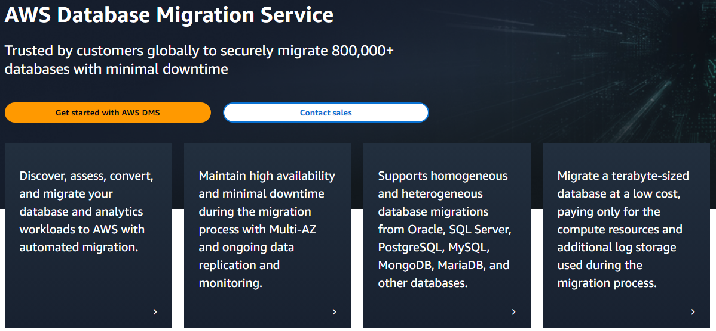
Step 3 – Design Phase
This is where UCB picks the appropriate tools to complete the migration. This includes the hardware as well as the software.
In terms of software, UCB should use AWS.
Its widely used so there’s lots of support and specialises in cloud migration
(figure 7, AWS features. Aws.co.uk, 2023)

Slide 12
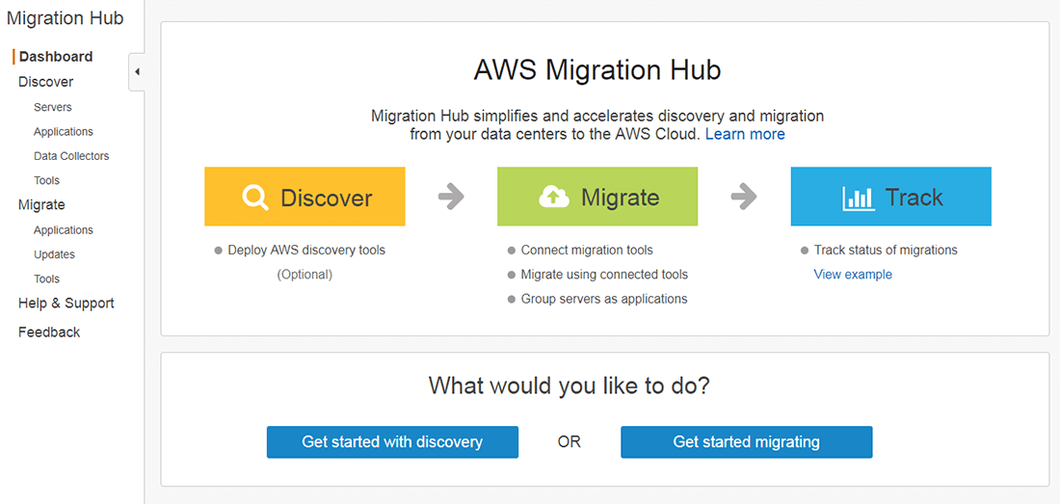
Step 4 - Execution
Now UCB is ready to start the 1st run at data migration. Using AWS migrating hub, the staff involved will begin a trial run of moving the data.
Its important to start off small, using a smaller sample size to test how smooth the operation works
In UCBs case, they could start of with the data from one building (e.g, data from courses in Moss House).
Figure 8, AWS migration hub. Aws.co.uk, 2023)

Slide 13
Step 5 – Evaluation and Repeat
Based on the results for the 1st run, UCB should evaluate when went right and wrong.
Then it’s time for a second run. Its important that UCB only move the data once they’re positive there will be no errors.
If there were no issues on the 1st run, Networking staff can begin full data migration.

Slide 14
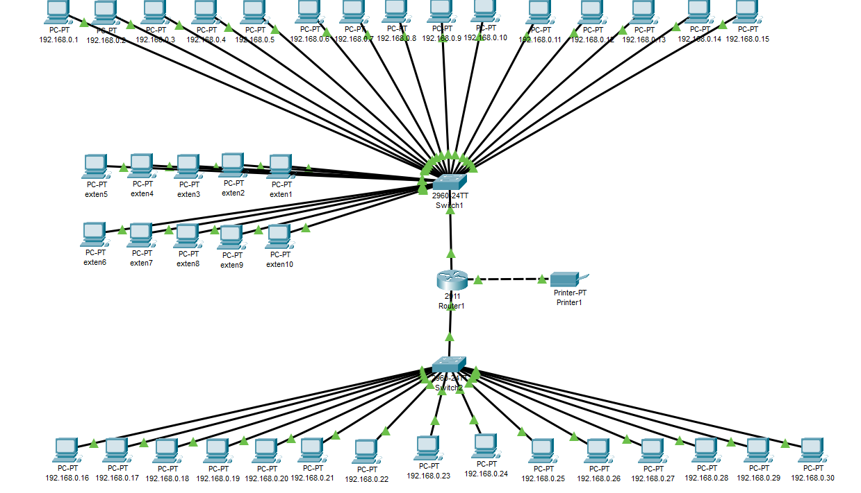
Final Step – implementation and monitoring
Now that the Data has completely been migrated, UCB can begin connecting the systems to the network in line with new design.
This is also where the networking staff should set up standard security measures such as a firewall to monitor the traffic at all times.
(figure 9, new network design, 2023)

Slide 15
Conclusion
To summarise, SDN allows a user to virtually take control over their network while behaving like a traditional network.
Mainly used to move data between locations but can also be used to visually represent a network.
While they can be cheaper and provide automated features, they introduce a learning curve alongside transfer issues. This should still be UCBs choice of technology to migrate since they have multiple buildings with lots of data
Before migrating, UCB needs to do an audit and invest in NAC software. When finished, they can begin the plan
They should test the software with a smaller amount of data, then increase and test until complete

Slide 16
Any Questions ?

Slide 17
References
VMware (2021). What is Software-Defined Networking (SDN)? | VMware Glossary. [online] VMware. Available at: https://www.vmware.com/topics/glossary/content/software-defined-networking.html.
YouTube. 2023. SDN, SD-WAN, & SD-Access Simplified... Seriously! - YouTube. [ONLINE] Available at: https://www.youtube.com/watch?v=dE7VUuXJs0k&ab_channel=KevinWallaceTraining%2CLLC. [Accessed 11 May 2023].
Adam Simmons. 2023. Software-Defined Networking (SDN) Explained - Dgtl Infra. [ONLINE] Available at: https://dgtlinfra.com/software-defined-networking-sdn/. [Accessed 11 May 2023].
Davies, N. (2022) SD-WAN: How to use it to transform your digital networks, Hashed Out by The SSL Store™. Available at: https://www.thesslstore.com/blog/sd-wan-how-to-use-it-to-transform-your-digital-networks/ (Accessed: April 20, 2023).
SDN architecture. The SDN Network Architecture has three tiers: The ... (no date). Available at: https://www.researchgate.net/figure/SDN-architecture-The-SDN-network-architecture-has-three-tiers-the-application-tier-the_fig2_329410780 (Accessed: April 20, 2023).
4 Benefits of Moving to Software-Defined Networking | GDIT. 2023. 4 Benefits of Moving to Software-Defined Networking | GDIT. [ONLINE] Available at: https://www.gdit.com/perspectives/latest/4-benefits-of-moving-to-software-defined-networking/. [Accessed 22 April 2023].
Xigent (2022) Security advantages of software defined networking (SDN), Xigent. Available at: https://xigentsolutions.com/blog/security-advantages-of-software-defined-networking/ (Accessed: April 22, 2023).
Google Cloud. 2023. Google Cloud overview | Overview. [ONLINE] Available at: https://cloud.google.com/docs/overview#:~:text=Google%20Cloud%20consists%20of%20a,location%20is%20in%20a%20region.. [Accessed 27 April 2023].
Amazon Web Services, Inc.. 2023. Cloud Computing Services - Amazon Web Services (AWS). [ONLINE] Available at: https://aws.amazon.com/. [Accessed 11 May 2023].

Slide 18
Xigent (2022) Security advantages of software defined networking (SDN), Xigent. Available at: https://xigentsolutions.com/blog/security-advantages-of-software-defined-networking/ (Accessed: April 22, 2023).
Google Cloud. 2023. Google Cloud overview | Overview. [ONLINE] Available at: https://cloud.google.com/docs/overview#:~:text=Google%20Cloud%20consists%20of%20a,location%20is%20in%20a%20region.. [Accessed 27 April 2023].
Amazon Web Services, Inc.. 2023. Cloud Computing Services - Amazon Web Services (AWS). [ONLINE] Available at: https://aws.amazon.com/. [Accessed 11 May 2023].
Portnox. 2023. Network Access Control - Portnox. [ONLINE] Available at: https://www.portnox.com/solutions/network-access-control/. [Accessed 11 May 2023].
Georgia Hispanic Chamber of Commerce. 2023. 5 STEPS TO SET SMART OBJECTIVES (EXAMPLES) – Georgia Hispanic Chamber of Commerce. [ONLINE] Available at: https://ghcc.org/en/5-steps-to-set-smart-objectives-examples/. [Accessed 11 May 2023].
Amazon Web Services, Inc.. 2023. Cloud Computing Services - Amazon Web Services (AWS). [ONLINE] Available at: https://aws.amazon.com/. [Accessed 11 May 2023].
Amazon Web Services, Inc.. 2023. Cloud Migration and Modernization Tools – AWS Migration Hub – Amazon Web Services. [ONLINE] Available at: https://aws.amazon.com/migration-hub/. [Accessed 11 May 2023].

